Slide 1

5G and Beyond: Emerging Technology in Mobile Networks
5G technology is revolutionizing mobile networks, offering unprecedented speeds and connectivity. This presentation explores 5G's features, evolution, and impact on various industries. We'll also peek into future technologies beyond 5G.

Slide 2

Introduction to 5G
High Data Rates
Ultra-Low Latency
5G enables multi-gigabit speeds, supporting data-intensive applications and services.
Near-instantaneous response times enable real-time applications and improved user experiences.
Massive Device Connectivity
5G supports a vast number of connected devices, facilitating IoT growth.

Slide 3
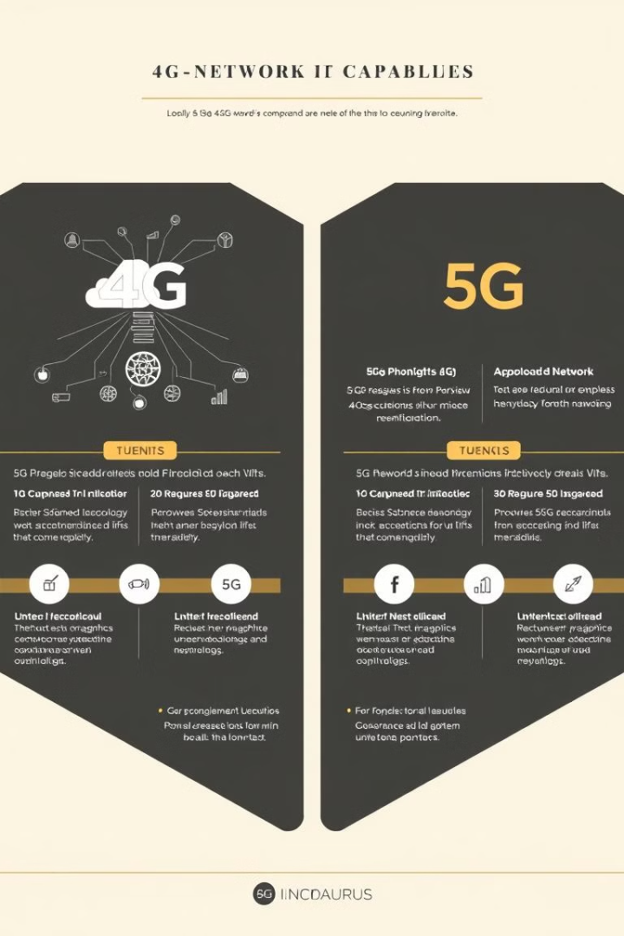
Evolution from 4G to 5G
1
4G LTE
Speeds up to 1Gbps, supporting high-definition video streaming and online gaming.
2
5G
Multi-gigabit speeds up to 10Gbps, enabling immersive AR/VR experiences and smart city applications.
3
Network Reliability
5G offers improved capacity and reliability, reducing network congestion and dropouts.

Slide 4
Core Technologies in 5G
Millimeter Waves (mmWave)
Massive MIMO
Beamforming and Network Slicing
Multiple antennas increase network capacity and improve spectral efficiency.
High-frequency waves enable ultra-fast data transmission in dense urban areas.
Focused signal transmission and customized network partitions optimize performance for specific use cases.

Slide 5


Applications of 5G
Smart Cities and IoT
Autonomous Vehicles
Remote Surgery
Enhanced Mobile Broadband
5G enables efficient urban management and connected infrastructure.
Ultra-reliable connections allow surgeons to operate remotely with precision.
Low-latency communication supports real-time decision-making for self-driving cars.
5G delivers faster speeds and improved capacity for mobile users.

Slide 6




Impact on IoT
Massive Device Density
5G supports millions of connected devices in small geographic areas.
Real-Time Processing
Low latency enables instant data analysis and decision-making for IoT applications.
Smart Ecosystems
5G facilitates seamless integration of smart homes, factories, and urban infrastructure.

Slide 7

Beyond 5G: Future Technologies
1
Terahertz Frequencies
2
AI-Powered Networks
6G will utilize higher frequencies, enabling unprecedented data transfer speeds.
Artificial intelligence will optimize network performance and resource allocation in real-time.
3
Satellite Integration
Future networks will seamlessly combine terrestrial and satellite communications for global coverage.

Slide 8

Challenges and Considerations
Challenge
Consideration
Infrastructure Costs
High investment required for widespread 5G deployment
Security Concerns
Increased connectivity raises new cybersecurity risks
Regulatory Hurdles
Spectrum allocation and policy frameworks need adaptation

Slide 9
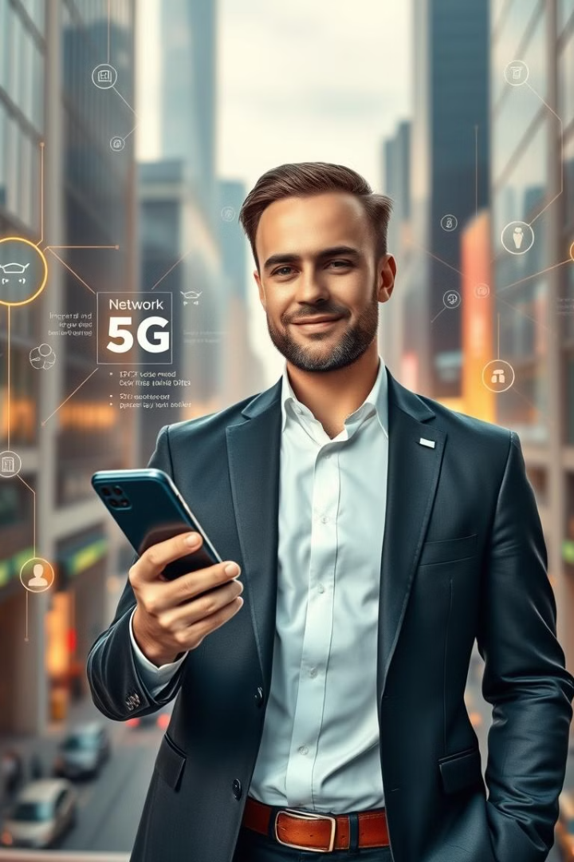
Conclusion
Transformative Technology
Continuous Evolution
5G will reshape industries and daily life, enabling new services and applications.
6G and beyond will further enhance connectivity, pushing the boundaries of communication technology.
Future-Ready
Embracing these advancements will be crucial for staying competitive in the digital age.

